Slide 1
Vehicle Security
Joseph Dillon
Karanbir Singh

Slide 2
WARNING
Hands-on labs and security presentations are provided for educational purposes only. Attendance at these sessions and the use of this information is not intended to promote unethical and illegal hacking, including cracking, software piracy or any other illegal activity as defined by state and federal laws. The word "hacking" in the context of these training sessions shall only refer to ethical hacking. All information provided in these sessions is for the sole purpose of providing the attendees with the tools to better understand vulnerabilities and in turn help prevent hacking attacks. Information garnered and equipment used during this session must not be used to cause damage by engaging in illegal hacking during or after the session. Any such behavior is a violation of state and federal laws and may subject to prosecution.

Slide 3
SDR

Slide 4
What is SDR?
Software Defined Radio
Signal is processed by the computer, not by hardware

Slide 5
Tools of the Trade
hackrf-sdr
GNUradio
Gqrx
FCC ID codes
da.gd/kevin

Slide 6
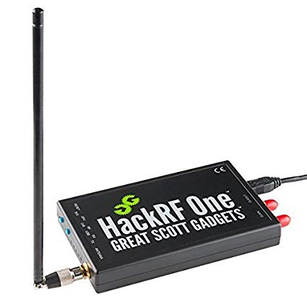
HackRF One

Slide 7
CANBUS

Slide 8
What is CANBus?
Underlying network for the car.
Carries all information from any module in a car.
Generally ends up being centralized in one location/compute, the ECU.

Slide 9
Origins
1980s
Largely unchanged
OEMs “Security through Obscurity” is worthless
Attach vectors broadening with new technologies, ie wi-fi hotspots in cars

Slide 10
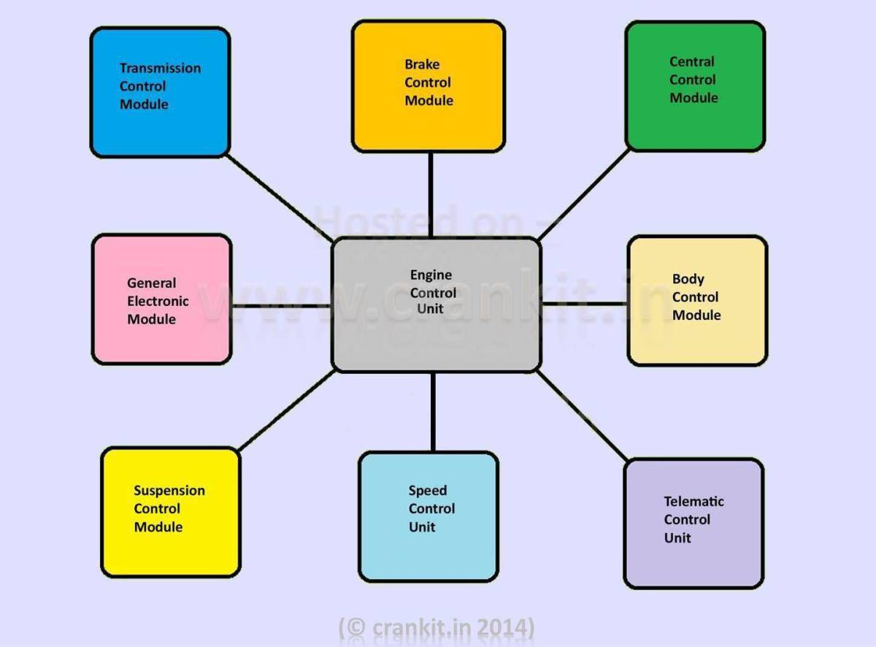
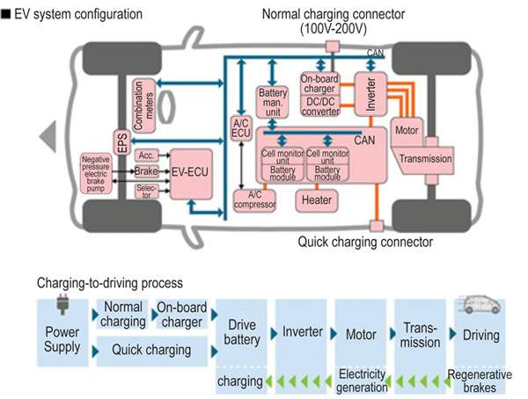

Slide 11
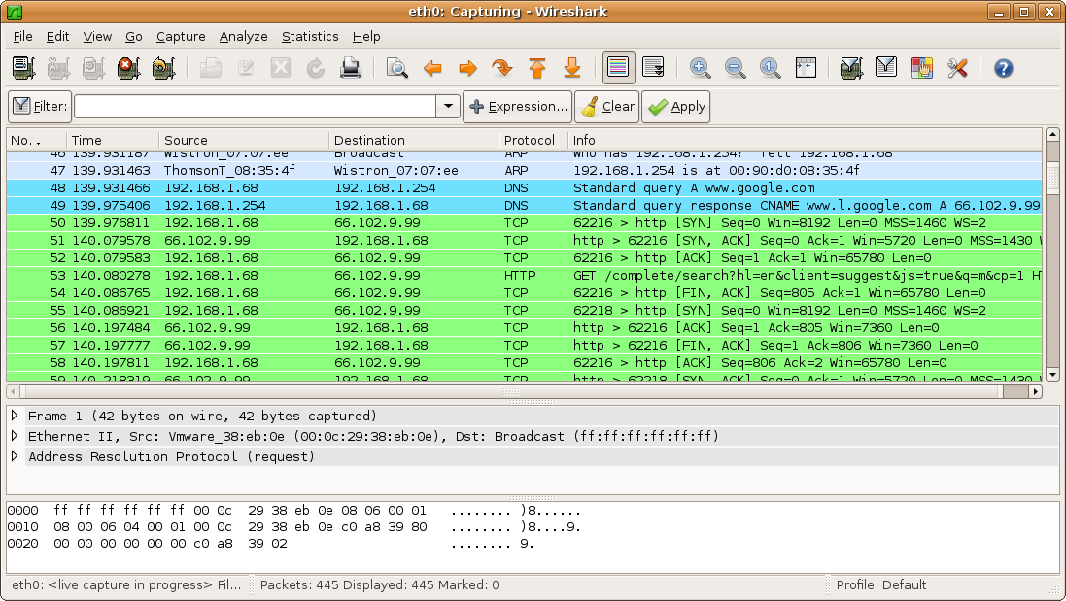
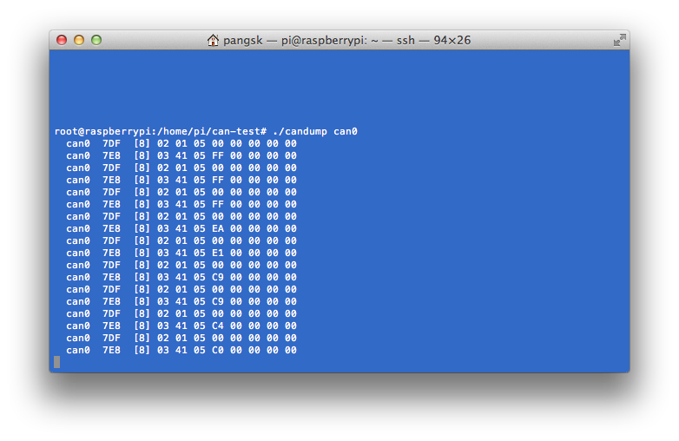

Slide 12
How to get Started in this mess
A laptop(Preferably running Linux)
A car that you feel comfortable breaking
USB to OBD2
Lots of patience
Anger management classes possibly

Slide 13
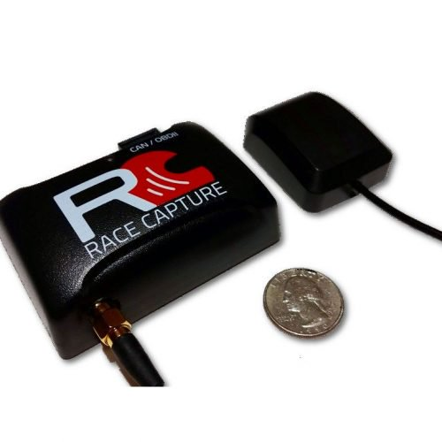
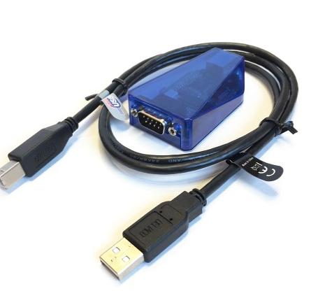
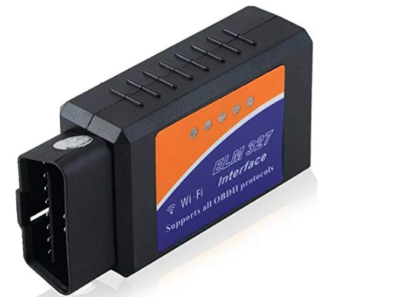
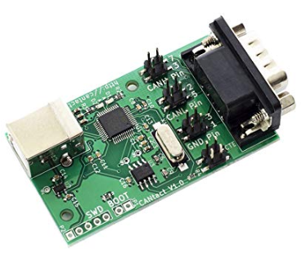
Options for Interfacing with CANBus
ELM327 $15
CANtact $75
CANUSB $120
Racecapture MK2/3 with a Pi $350 or $650
Racelogic VBox $1000+

Slide 14
Software
Can-utils
SavvyCAN
Kayak(Kajak)
ICSim
UDSim

Slide 15
Disclaimer
Jack your car up
Keep the Parking Brake on
I am, once again, not responsible if you break your car

Slide 16
Virtual CAN
sudo modprobe can
sudo modprobe vcan
sudo ip link add dev vcan0 type vcan
sudo ip link set up vcan0
./icsim vcan0
./controls vcan0

Slide 17
tools
Candump
Candump can0
Cangen
Cangen can0 -g 4 -I IC4 -D i
Cansniffer
cansend

Slide 18
Physical CAN
Sudo wlcand -o -c s-6 /dev/ttyACM0 can0
Sudo ifconfig can0 up

